Slide 1
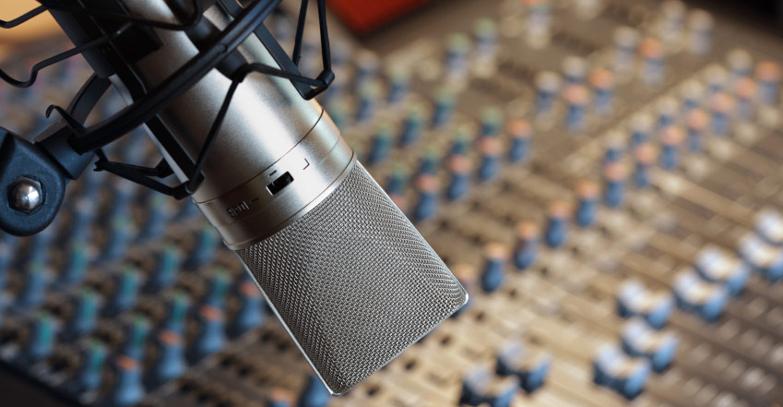

Mo’ Signal Mo’ Betta
MULTI-MICROPHONE DENOISING
Karl Ni
Notes:
Spread out microphones throughout the room
Isolate
Denoise

Slide 2
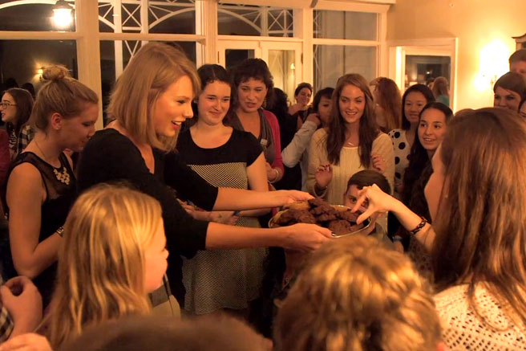
Notes:
Your house sitter had a party while you were gone and someone broke your vase!
Luckily, you’ve placed a lot of microphones around in the room.
You were in a hurry, though, and just threw them out there.
Keypoint: distribute microphones arbitrarily.

Slide 3
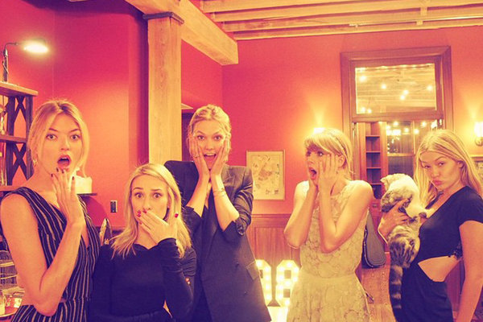
Notes:
2 Things:
- How many people at this party?
- Who broke your vase?

Slide 4

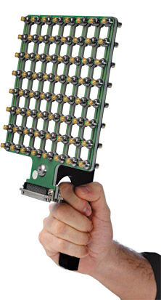

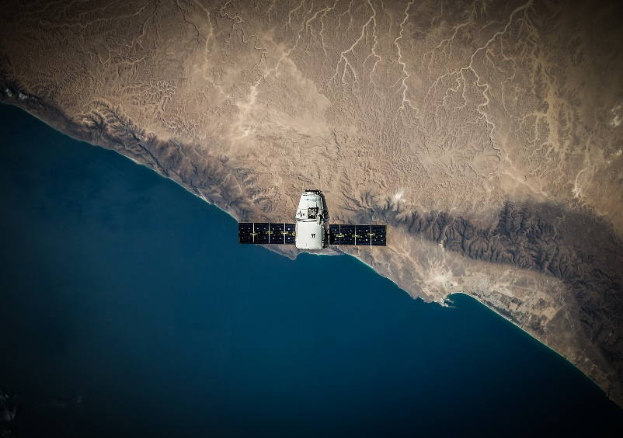



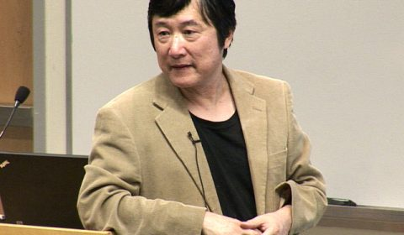


WHY THIS? WHY NOW?
STATE OF THE ART & RELATED WORK
WHAT’S OUT THERE?
SINGLE SENSOR
SENSOR ARRAY
DSP-BASED
WHY NOW?
Notes:
Timeline slide
SINGLE SENSOR
HIGH ERROR RATES
PROBLEM UNSOLVED IN 20 YEARS
SENSOR ARRAY
HIGHLY CALIBRATED
KNOWN PLACEMENT
SYNCHRONIZED TIMING
POOR COVERAGE
EXPENSIVE
DSP-BASED
NONLINEAR EFFECTS

Slide 5


WHY SHOULD YOU CARE?
IMPACT, RELEVANT, AND COLLABORATION
OPERATIONAL
ECONOMIC
MISSION
Notes:
Impact
(Operational) PAG: Quick sensor placement & reliable data recovery
(Economic) Cheap COTS alternative that is simple and works
(Mission) Capability in enhances problems in other speech areas
(Community) Lab41 and IQT

Slide 6
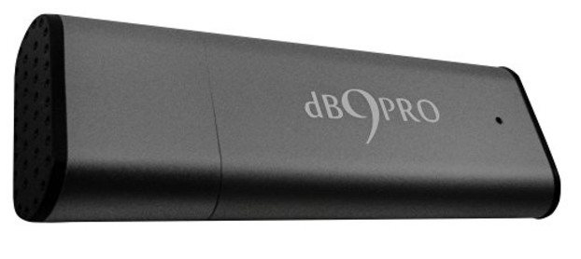
WHAT DO WE NEED?
SPECIFICS AND REQUIREMENTS
10 Amazon microphones $43.29. (Cheaper ones: $16.32)
Two FTE at 6 months
Travel costs
4 offsite campaign
Legal Advisement on Recording
Notes:
Timeline slide

Slide 7






EMAIL
kni@iqt.org
PHONE
650-690-5347
WEBSITE
www.lab41.org
BLOG
www.lab41.org/gab41
Notes:
Contact slide. Feel free to change to suit your needs

